Slide 1
Chapter 5: CPU Scheduling
Basic Concepts
Scheduling Criteria
Scheduling Algorithms
Multiple-Processor Scheduling
Real-Time Scheduling
Algorithm Evaluation

Slide 2
Basic Concepts
object :
  Maximum CPU utilization obtained with multiprogramming
foundation:
  CPU–I/O Burst Cycle – Process execution consists of a cycle of CPU execution and I/O wait.
  CPU burst distribution
  most the bust is very short

Slide 3

Alternating Sequence of CPU And I/O Bursts

Slide 4

Histogram of CPU-burst Times

Slide 5
CPU Scheduler
Selects from among the processes in memory that are ready to execute, and allocates the CPU to one of them.
CPU scheduling decisions may take place when a process:
  1. Switches from running to waiting state.
  2. Switches from running to ready state.
  3. Switches from waiting to ready. ????
  4. Terminates.
Scheduling under 1 and 4 is nonpreemptive.
All other scheduling is preemptive.

Slide 6
preemptive and nonpreemptive
Scheduling under 1 and 4 is nonpreemptive.
  not efficient
  not protect the CPU from being abused
All other scheduling is preemptive
  preemptive scheduling incurs potential data inconsitant ----really ？
  and need synchronization mechanisms
  if process can be preempted in kernel mode, it will be......
  one solution is: the kernel is not preemptive,----> not for realtime application

Slide 7
Dispatcher
Dispatcher module gives control of the CPU to the process selected by the short-term scheduler; this involves:
  switching context
  switching to user mode
  jumping to the proper location in the user program to restart that program
Dispatch latency – time it takes for the dispatcher to stop one process and start another running.
  since it is wasted, dispatcher should be fast.

Slide 8
Scheduling Criteria
CPU utilization – keep the CPU as busy as possible
Throughput – # of processes that complete their execution per time unit
Turnaround time – amount of time to execute a particular process
Waiting time – amount of time a process has been waiting in the ready queue
Response time – amount of time it takes from when a request was submitted until the first response is produced, not output (for time-sharing environment)

Slide 9
Optimization Criteria
Max CPU utilization
Max throughput
Min turnaround time
Min waiting time
Min response time
maybe we use some criteria
in some circumstances, wo use one criteria:
  interactive system, we use response time
  minimizing variance in response time is more prefered

Slide 10
First-Come, First-Served (FCFS) Scheduling
Process Burst Time
P₁ 24
P₂ 3
P₃ 3
Suppose that the processes arrive in the order: P₁ , P₂ , P₃
The Gantt Chart for the schedule is:
Waiting time for P₁ = 0; P₂ = 24; P₃ = 27
Average waiting time: (0 + 24 + 27)/3 = 17
P₁
P₂
P₃
0
24
27
30

Slide 11
FCFS Scheduling (Cont.)
Suppose that the processes arrive in the order
P₂ , P₃ , P₁ .
The Gantt chart for the schedule is:
Waiting time for P₁ = 6; P₂ = 0; P₃ = 3
Average waiting time: (6 + 0 + 3)/3 = 3
Convoy effect short process behind long process
  a long CPU-burst process and many IO-bound processes, the first one take the CPU and keep the others waiting
P₂
P₃
P₁
0
3
6
30

Slide 12
Shortest-Job-First (SJR) Scheduling
Associate with each process the length of its next CPU burst. Use these lengths to schedule the process with the shortest time.
Two schemes:
  nonpreemptive – once CPU given to the process it cannot be preempted until completes its CPU burst.
  preemptive – if a new process arrives with CPU burst length less than remaining time of current executing process, preempt. This scheme is know as the
  Shortest-Remaining-Time-First (SRTF).
SJF is optimal – gives minimum average waiting time for a given set of processes.

Slide 13
Example of Non-Preemptive SJF
Process Arrival Time Burst Time
P₁ 0.0 7
P₂ 2.0 4
P₃ 4.0 1
P₄ 5.0 4
SJF (non-preemptive)
Average waiting time = (0 + 6 + 3 + 7)/4 =16/ 4
FCFS: =(0 +5+7+7)/4=19/4
P₁
P₃
P₂
P₄
0
3
7
8
12
16

Slide 14
Example of Preemptive SJF
Process Arrival Time Burst Time
P₁ 0.0 7
P₂ 2.0 4
P₃ 4.0 1
P₄ 5.0 4
SJF (preemptive)
Average waiting time = (9 + 1 + 0 +2)/4 = 3
P₁
P₂
P₃
P₂
P₄
P₁
0
2
4
5
7
11
16

Slide 15
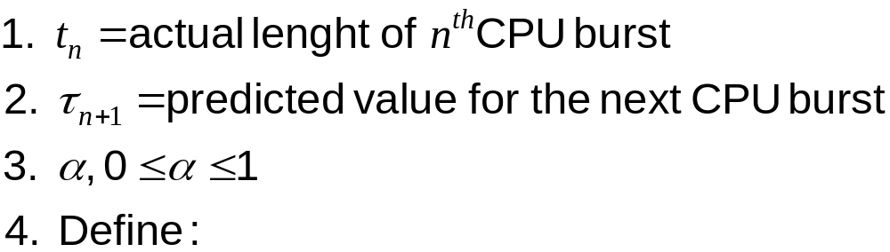
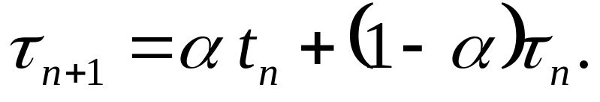
Determining Length of Next CPU Burst
Can only estimate the length.
Can be done by using the length of previous CPU bursts, using exponential averaging.

Slide 16


Prediction of the Length of the Next CPU Burst
0 1 2 3 4 5 6 7
6 4 6 4 13 13 13 13
10 8 6 6 5 9 11 12

Slide 17
Examples of Exponential Averaging
α =0
  τ_{n+1} = τ_{n}
  Recent history does not count.
α =1
  τ_{n+1} = t_{n}
  Only the actual last CPU burst counts.
If we expand the formula, we get:
    τ_{n+1} = α t_{n}+(1 - α) α t_{n-1} + …
    +(1 - α )^{j} α t_{n-j} + …
    +(1 - α )^{n+1} τ₀
Since both α and (1 - α) are less than or equal to 1, each successive term has less weight than its predecessor.

Slide 18
Priority Scheduling
A priority number (integer) is associated with each process
  internally: determined by memory requirenent, the ratio of IO/CPU
  externally: associated with user, process type
The CPU is allocated to the process with the highest priority (smallest integer ≡ highest priority).
  Preemptive
  nonpreemptive
SJF is a priority scheduling where priority is the predicted next CPU burst time.
Problem: Starvation – low priority processes may never execute.
Solution: Aging – as time progresses increase the priority of the process.

Slide 19
Aging algorithm
Highest Response Ration Next Scheduling
Wait time + Job time
Response Ratio = --------------------------------
Job time

Slide 20
Round Robin (RR)
Each process gets a small unit of CPU time (time quantum), usually 10-100 milliseconds. After this time has elapsed, the process is preempted and added to the end of the ready queue.
If there are n processes in the ready queue and the time quantum is q, then each process gets 1/n of the CPU time in chunks of at most q time units at once. No process waits more than (n-1)q time units.

Slide 21
Example of RR with Time Quantum = 4
Process Burst Time
P₁ 24
P₂ 3
P₃ 3
The Gantt chart is:
average waiting time is (6+4+7)/3=5.66
Typically, higher average turnaround than SJF,
but better response.
P₁
P₂
P₃
P₁
P₁
P₁
P₁
P₁
P₃
P₃
0
4
7
10
14
18
22
26
30
154
162

Slide 22

Time Quantum and Context Switch Time
Performance
        q large ⇒ FcFS
  q small ⇒ q must be large with respect to context switch, otherwise overhead is too high.

Slide 23
Multilevel Queue
Ready queue is partitioned into separate queues:
foreground (interactive)
background (batch)
Each queue has its own scheduling algorithm,
foreground – RR
background – FCFS
Scheduling must be done between the queues.
  Fixed priority scheduling; (i.e., serve all from foreground then from background). Possibility of starvation.
  Time slice – each queue gets a certain amount of CPU time which it can schedule amongst its processes; i.e., 80% to foreground in RR, 20% to background in FCFS

Slide 24

Multilevel Queue Scheduling

Slide 25
Multilevel Feedback Queue
A process can move between the various queues; aging can be implemented this way.
Multilevel-feedback-queue scheduler defined by the following parameters:
  number of queues
  scheduling algorithms for each queue
  method used to determine when to upgrade a process
  method used to determine when to demote a process
  method used to determine which queue a process will enter when that process needs service

Slide 26
Example of Multilevel Feedback Queue
Three queues:
  Q₀ – time quantum 8 milliseconds
  Q₁ – time quantum 16 milliseconds
  Q₂ – FCFS
Scheduling
  A new job enters queue Q₀ which is served FCFS. When it gains CPU, job receives 8 milliseconds. If it does not finish in 8 milliseconds, job is moved to queue Q₁.
  At Q₁ job is again served FCFS and receives 16 additional milliseconds. If it still does not complete, it is preempted and moved to queue Q₂.

Slide 27

Multilevel Feedback Queues

Slide 28
Multiple-Processor and multi-core Scheduling
CPU scheduling more complex when multiple CPUs or multi-core are available.
presumption
  Homogeneous processors within a multiprocessor.
  UMA--uniform memory access
Load sharing －－using common queue
  access protection---ready queue access
Asymmetric multiprocessing – only one processor accesses the system data structures, alleviating the need for data sharing.
  drawback: the server CPU may be bottle-neck

Slide 29
Multiple-Processor Scheduling
Throughput
  The throughput of an SMP system is mainly dependent on:
  A consistently high level of workload concurrency. More dispatchable threads than processors at certain times cannot compensate for idle processors at other times.
  The amount of lock contention.
  The degree of processor affinity

Slide 30
Multiple-Processor Scheduling
Response Time
The response time of a particular program in an SMP system is dependent on:
  The process-concurrency level of the program. If the program consistently has two or more dispatchable threads, its response time will probably improve in an SMP environment. If the program consists of a single thread, its response time will be, at best, comparable to that in a uniprocessor of the same speed.
  The amount of lock contention of other instances of the program or with other programs that use the same locks.
  The degree of processor affinity of the program. If each dispatch of the program is to a different processor that has none of the program's cache lines, the program may run more slowly than in a comparable uniprocessor.

Slide 31
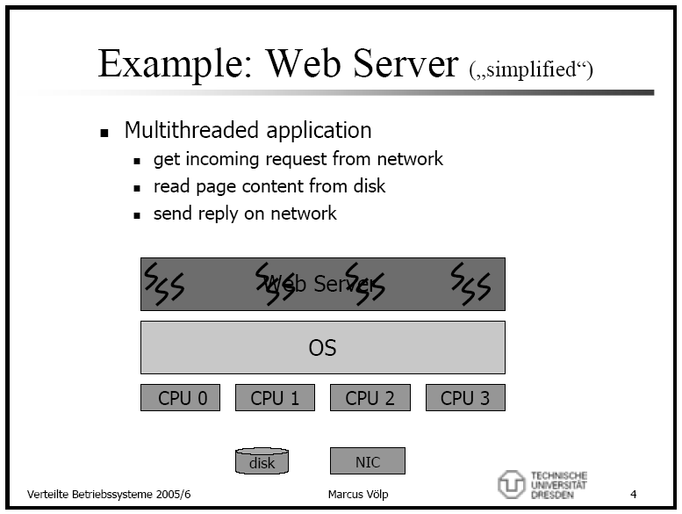

Slide 32
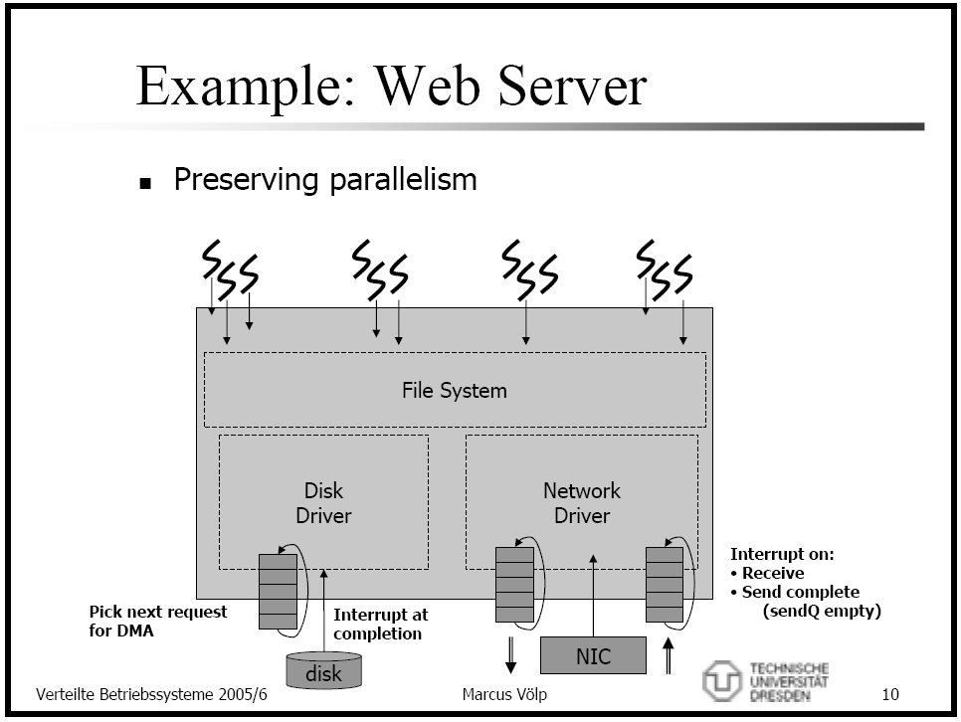

Slide 33
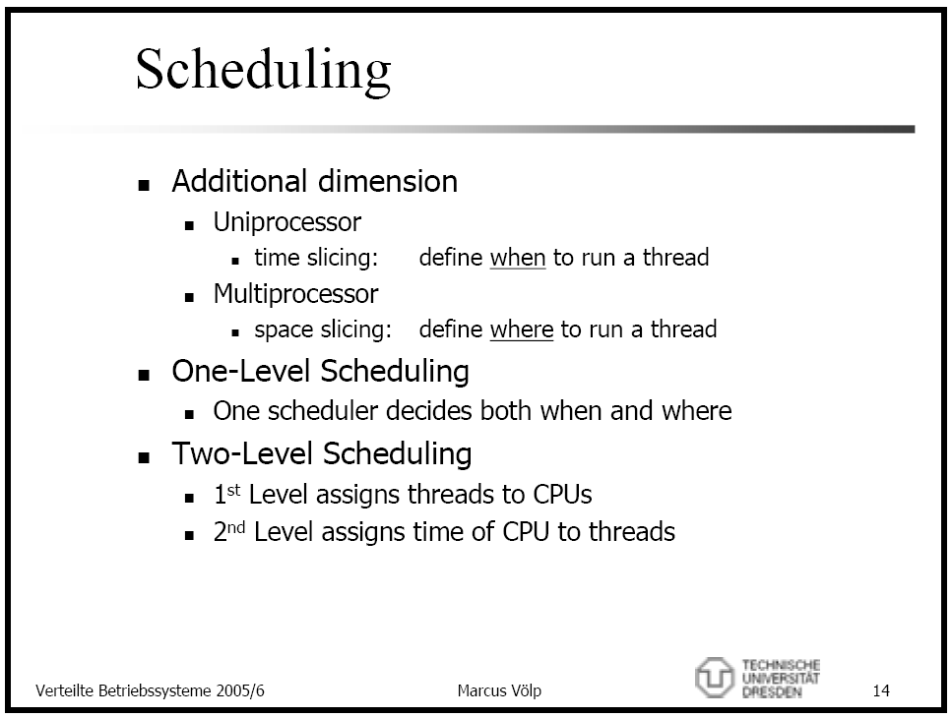

Slide 34
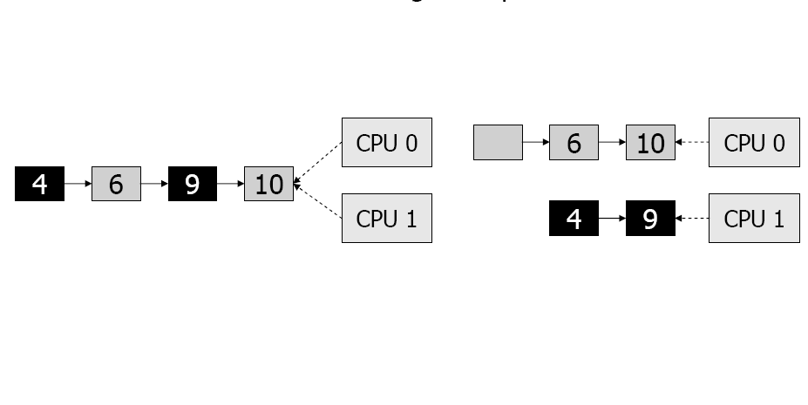
A detailed Example: Ready Qeue
local vs. global queues

Slide 35
SMP scheduling Linux/NT
Linux chooses a CPU to run a process in the following sequence:
  Is the CPU that was last running p
  Does an idle processor exist that can execute p
  Does there exist a processor that can execute p and whose current process has lower dynamic priority than p

Slide 36
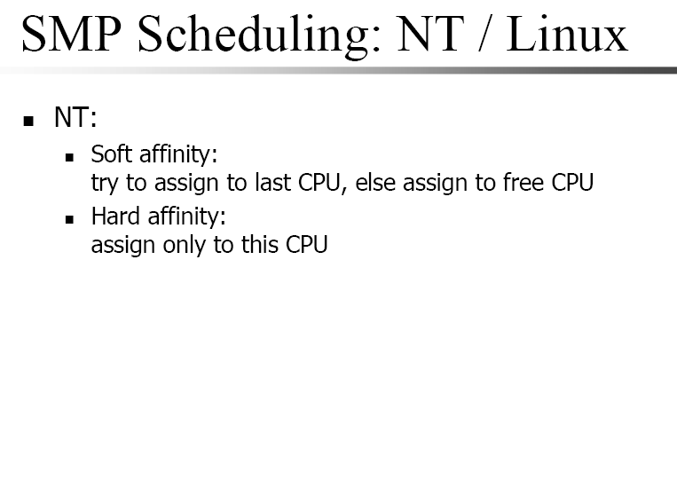

Slide 37
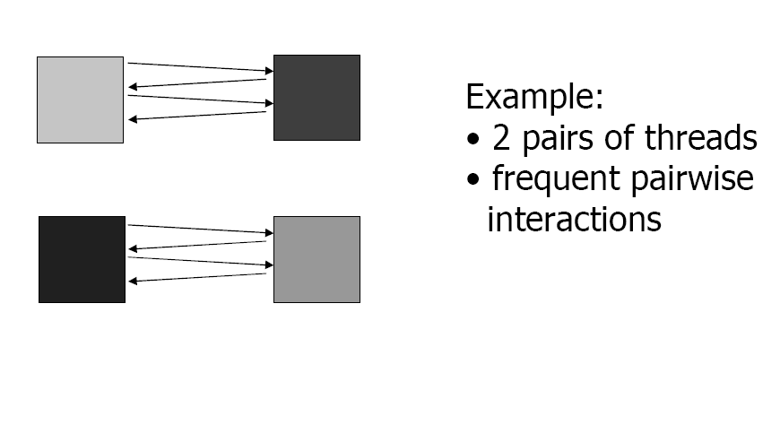
SMP Scheduling: Gang Scheduling

Slide 38
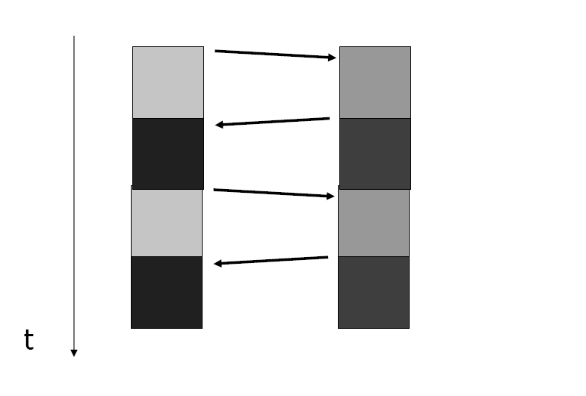
SMP Scheduling: Gang Scheduling

Slide 39
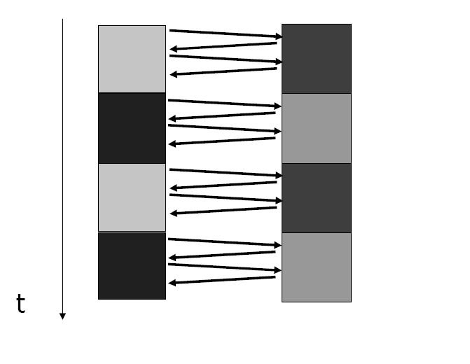
SMP Scheduling: Gang Scheduling
Schedule pairs ---the gang ---together

Slide 40
Real-Time Scheduling
Hard real-time systems – required to complete a critical task within a guaranteed amount of time.
  resource reservation: admit or reject
  operation or IO time is known-----impossible for system with disk or virtual memory
Soft real-time computing – requires that critical processes receive priority over less fortunate ones.
  priority based scheduling---realtime process priority does not degrade
  dispatch latency is small

Slide 41
to lower the dispatch latency
unpreemptive kernel: dispatch latency is long
to allow kernel preemptive
  preemption point---data safe state
  entire kernel preemptible----access protection
  priority inversion: the high priority process need the resource being accessed by lower priority process
conflict phase
  preemption of the process in kernel
  release the resources
solaris 2
  preemption disable ----dispatch latency is 100 milliseconds
  preemption enableed----2 milliseconds

Slide 42

Dispatch Latency
conflicts time: preempt process, release the resources needed
Notes:
精确的估计中断的处理时间

Slide 43
Algorithm Evaluation
select the criteria
  CPU utilization, turnaround time
Deterministic modeling – takes a particular predetermined workload and defines the performance of each algorithm for that workload.
  for a kind of or same tasks
  how to get a series chart ?

Slide 44
Algorithm Evaluation
Queueing models
  n = λ×W
  n: queue len; λ: arrival rate; W: waiting time
  get two, get the 3rd
  14=7*2
  limitation--unrealistic, not accurate
simulations
  programming a computer system model
  get data----processes, CPU burst,
    random generated----poisson distribution
    statistic

Slide 45

Evaluation of CPU Schedulers by Simulation

Slide 46
Algorithm Evaluation
Implementation
  cost of changing the kernel code
  affect the user
  environment changing----use change their programs to gain benefit
  flexible scheduling algorithm--altered, configered

Slide 47
Solaris 2 Scheduling
priority based
LWP is scheduling unit
multilevel feed back for time-sharing and interactive processes
system class
realtime class

Slide 48
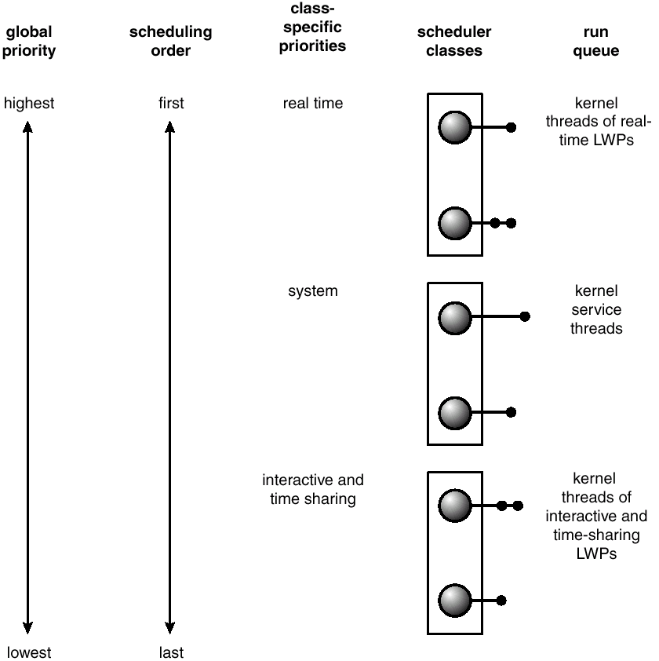
Solaris 2 Scheduling

Slide 49

Solaris Dispatch Table

Slide 50
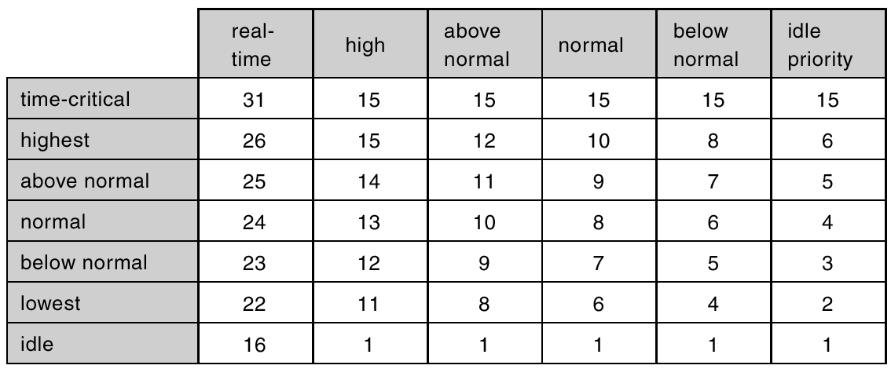
Windows 2000 Priorities
priority lower: use up the time quantum
priority boost: after I/O
foreground and background process

Slide 51
Windows 2000 Priorities
priority based, preemptive
multilevel-feedback in the same class
  priority can be changed in the same class
  lowered after time quantum
  boost the priority after I/O-- degree depends on the I/O type, keyboard,disk
foreground and background process

Slide 52
Linux scheduling
time sharing
  credits------aging
  Prioritized credit-based – process with most credits is scheduled next
  Credit subtracted when timer interrupt occurs
  When credit = 0, another process chosen
  When all processes have credit = 0, recrediting occurs
  Based on factors including priority and history
  recrediting when no runnable process
  credits = credits/2 +priority
  CPU bound processes will get low credits
  I/O bound processes will get high ctedits

Slide 53
Linux Scheduling
Real-time
  Soft real-time
  Posix.1b compliant – two classes
    FCFS and RR
    Highest priority process always runs first

Slide 54

The Relationship Between Priorities and Time-slice length

Slide 55

List of Tasks Indexed According to Prorities

Slide 56
question
the above algorithm is the maxmize the utililization of CPU
If another resource is more rare, more critical, maybe we should design this resource oriented scheduling algorithm.
  memory using optimization

